Slide 1
Simulation for the Auditor
Daniel McCarville • Internal Auditor • Statistics Researcher • daniel.mccarville@gmail.com
Notes:
About me - what’s my connection to simulation?
Brief 1-2 sentences about what simulation is.

Slide 2
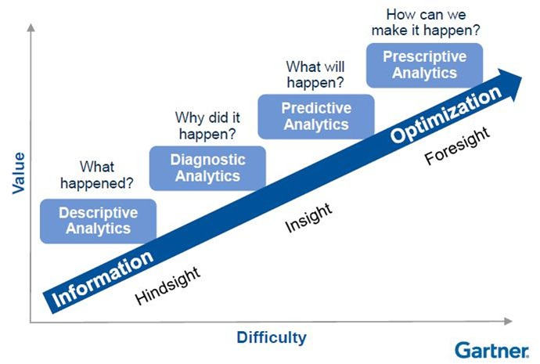
Notes:
Set Expectations:
Simulation is not right for every project.
Define prescriptive analytics
It’s an example of Prescriptive Analytics. - Tell the auditee what the ideal course of action is.

Slide 3
What are we here for?
Intro to Simulation
Demo
Example Project
Playbook
DEC
What is simulation? Why would I use it?
Demonstrate how a simulation works and how to build one.
Explore an example simulation project.
A checklist-approach to implementing your first model.
Notes:
Learning goals:
Learn about a new technique.
Be able to identify when a project is right for simulation.
Build a foundation for implementing a simulation project.

Slide 4
1.
Intro to Simulation
Intro to Simulation
Demo
Example Project
Playbook
DEC
What is simulation? Why would I use it?

Slide 5
What is simulation?
A digital model of a real process or activity.
Life-like
Simplifications
Stochastic
Controlled
Notes:
A simulation is a model of a real process or activity. Think about a model of a building: it has all the important parts that a real building does, but it’s not a real building. What is an “important part”? That depends on what you want to use it for!
We can build computerized models of business processes. Those models will have the features we need for our analysis, but we can control them in our computerized environment.

Slide 6
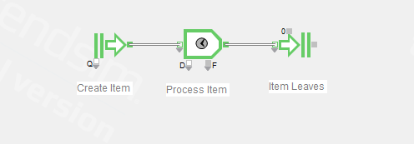
Discrete Event Simulation
Notes:
We are going to be talking about a specific kind of simulation, called Discrete-Event Simulation (DES). DES is good for simulating anything that can be represented as a flow chart. If a Visio flow chart is a static image, simulation is how you animate that process and watch it come to life.
We’ll see more of these, but here’s a simple example. Something is created, processed, then destroyed.

Slide 7
Why?
Simulation is perfect for “what-if” scenarios:
Changes in the marketplace
Changes in regulation
Changes as the business grows/shrinks
Effects of disasters and rare events
Interactions of different changes
Notes:
By the way - your recommendations are a change. What happens to the business when your recommendation was implemented? Does it resolve the problem? Does it cause other problems somewhere else? Is it prohibitively costly?

Slide 8
Simulation vs Machine Learning
 | Machine Learning | Simulation
Inputs | Known | Unknown (Random)
Model | Unknown (Random) | Known
Key Assumption | Training data will resemble data in production | Business process in simulation matches real process
Notes:
ML can’t tell us much about hypothetical situations. That gets to the problem of generalization error. If the hypothetical future data is different from what the model is trained on, you won’t get reliable
results. Unfortunately, that’s what we need.
Simulation takes the opposite tack: we know the model because it’s our business process. We don’t know the input data, which is thall the random business context we are going to alter.
These perspectives lead to very different approaches.
ML projects are essentially context free. You get the data, you explore the data, you find things in data.
Simulation projects are context heavy. You will spend most of your time thoroughly understanding the business process. Reading their docs, having lots of interviews, asking lots of questions, hopefully observing the process on site (if possible). And sure, exploring data. But only when needed.
WHO DOES SIMULATION
Actuaries (look at valuation of equity awards)
Industrial Engineers
Scientists

Slide 9
2.
Demo
Intro to Simulation
Demo
Example Project
Playbook
DEC
Demonstrate how a simulation works and how to build one.
Notes:
This is where I provided a demo of the ExtendSim software. I created a real model showing how we could simulate business activity and experiment with different scenarios.

Slide 10
3.
Example Project
Intro to Simulation
Demo
Example Project
Playbook
DEC
Explore an example simulation project.
Notes:
Having seen the basics of how discrete event simulations work, what are some use cases?
These are actual examples from projects I’ve been on. They are intended to help foster ideas for what you can do it your organization. The basic flow is to introduce each project, then delve into why this was a solid use case.

Slide 11
Example Project - Psychiatric Prison
State psychiatric prison for violent sexual offenders:
Inmates stay until they complete a 7-step therapy program
21 years of operation, only 3 people ever succeeded
Climbing population and ballooning costs
Notes:
28 died of old age while in SPTP. Only 3 completed it. Nursing care is required for a lot of these people. 243 currently in program.

Slide 12
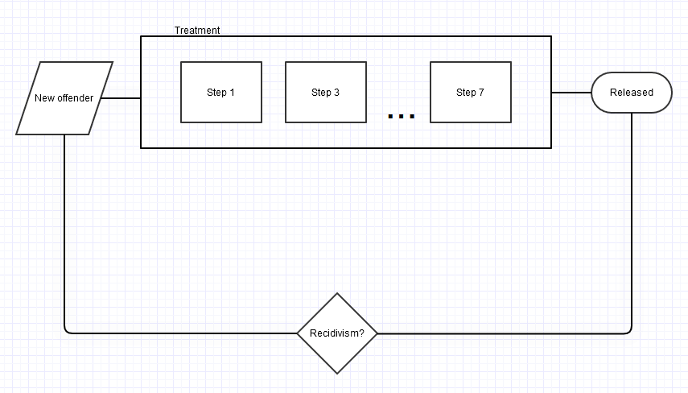
Notes:
The business process seemed really difficult, but we collapsed it into a very manageable model.
First, offenders enter the model. We used real offender data and we were able to model this fairly precisely. A big part of the model involved forecasting the current population. To do that, the model started filled with current residents. These were all based on their real profiles. Each offender was the correct age, in the right step, etc.
Often you will want to give the items in your simulation properties. In this case, an offender has many properties. Some of the key ones:
— Age and life expectancy
— Intellectual/developmental disability
— Willingness to participate in treatment
— Est. time needed in treatment
These were all based on real values, with estimation used as needed. For example, we could use actuarial data to estimate life expectancy.
The treatment process seemed hard to define, but it’s essentially just seven different “process” steps. Each step has a different distribution which defines how long treatment takes. For example, one step might be a uniform distribution between 8 - 24 months. That would mean it takes 8-24 months to complete, and every number is equally likely. Another step might be a beta distribution, or exponential, or any number of things. Data modeling is a major skill for the statistical side of simulation.
We included a feedback step. The auditee felt strongly that recidivism was unacceptable. So we used a simple method to estimate how likely recidivism was. Every offender had the same chance of committing a new crime each year. This allowed us an estimate of the risk to the public.
There are some important traits not pictured:
— Each year, residents age. At a certain age they become medically infirm and no longer make progress toward treatment. Eventually they die.
— Residents who commit a crime while in SPTP go back to a normal prison. We included a mechanism to take them out of the model.

Slide 13
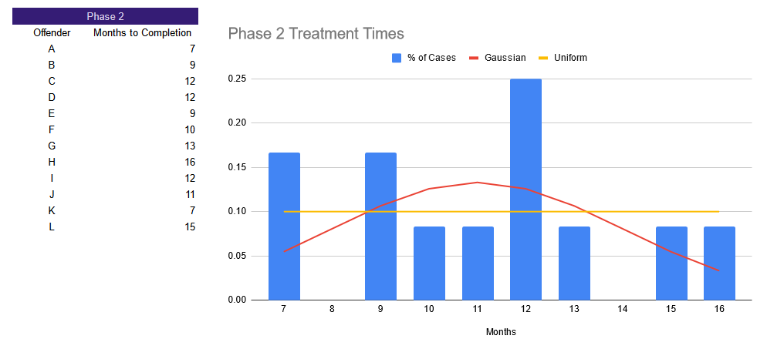
Notes:
For each step in the model, we had to describe how long that step takes. We collected data from real offenders in SPTP and decided on the most appropriate distribution. In this way, our model was reasonably life-life.

Slide 14
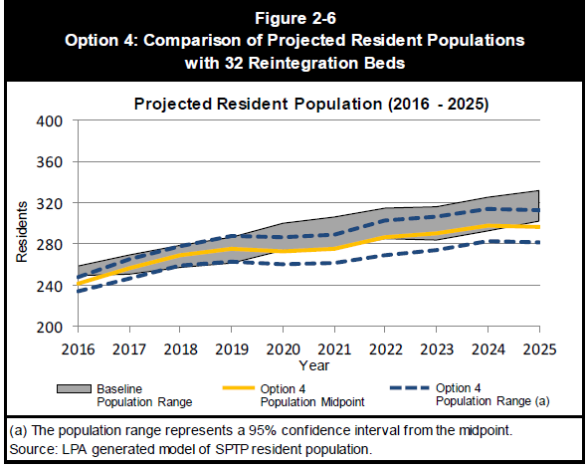
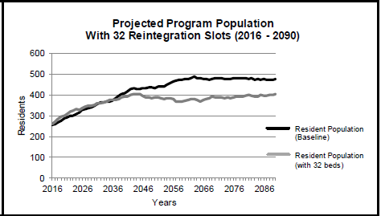
Notes:
A simulation is able to forecast future events. The “baseline” forecast is how the facility population would look decades from now if management didn’t change anything. Audit identified a bottleneck: a critical step of the process could only accommodate 16 people. We recommended increasing it to 32. The grey line shows how implementing this finding would reduce the forecast.

Slide 15
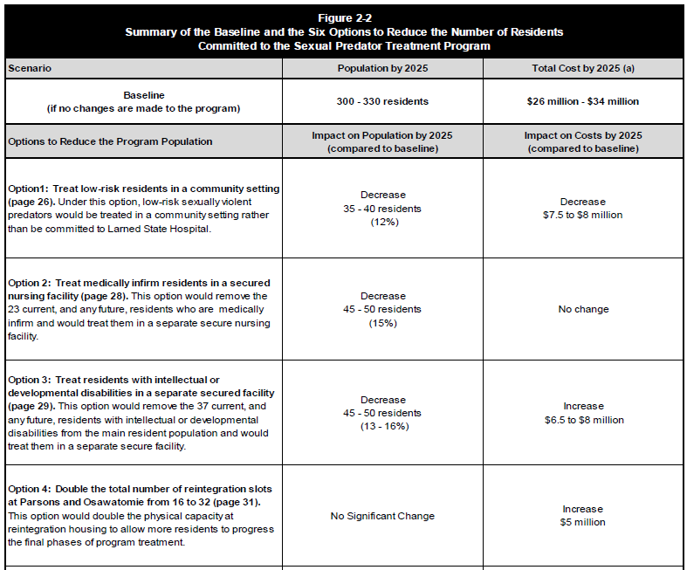
Notes:
This is an example of our finding. We not only forecasted the benefit (the future population of the facility), but the costs as well.

Slide 16
4.
Playbook
Intro to Simulation
Demo
Example Project
Playbook
DEC
A checklist-approach to implementing your first model.

Slide 17

Playbook: Planning
Vision
Why are we doing this? What are the high-level project needs?
Scope
What processes are we including? What are we excluding?
Preliminary Flow Chart / POC
Auditor develops a Visio (static) flow chart or super-simple model.
Lead auditor should approve the concept.
Notes:
These are critical items to consider when implementing a computer simulation.

Slide 18
Playbook: Design
Inputs
Key assumptions, facts, item to be simulated, etc.
Variables or Scenarios
What will change between tests?
Outcomes
What data will you collect? What metric are you optimizing?
Scenario 1
Inputs
Output Data
Scenario 2
Notes:
The statistical part of the model has some key design considerations.
What are the “givens”? That includes the overall flow of the business process, the items flowing through the model, and key assumptions you need to make. In the example, the model was a multi-step treatment process at a psychiatric facility. The “items” are people moving through treatment. We made many assumptions about how long different phases of treatment take, lifespans, etc.
What variables will you test in each scenario? These need to be built in, and you need to model their effects on the process. In the example, we compared the baseline (16 beds in a key step) to a proposed improvement (increasing it to 32 beds).
Finally, what data do we need to collect? What KPI are we optimizing? In this example we wanted to observe the facility population, but we were also interested in the overall cost of the program. So the model needs to capture that data.

Slide 19
Playbook: Build
Unit Testing
Build one piece at a time. Test that piece. Then move on.
Use the Status Quo
Validate the baseline model against real world data.
Document Extensively
Document each piece you build. Everything. You’ll thank yourself later.
Notes:
How will you bild the model? It can be a daunting process. I recommend unit testing: built it one piece at a time, and test that piece. That way you have confidence that each part works appropriately.
You can validate your model against the current world. We tested our model on past year’s data. We could see that the “forecast” for past years was very close to the actual historical performance.

Slide 20
Playbook: Run the Model
Full Run
Test Run
Sample Sizes
Notes:
The “full run” means running all the data we need. That’s hundreds or thousands of replications for each scenario or setting we are testing. A complex model on a low powered machine could take several days. An efficient model on a high-performance cluster could be 20 minutes.
The test run is a small batch: use your baseline settings and run a relatively small number (maybe 100) replications. Measure the time it takes to run. Get the output data and measure the variance.
Use the variance to calculate the sample size you need for the full run. Use the time from the test run to estimate how long the full run will take. Most simulation tools will have a feature to alert you when the run is done, but you will probably want some idea how long you will be waiting.

Slide 21
Playbook: Data Analysis & Workpapers
Simple:
Observe the outcomes
T-Test
Workpaper:
Reference the notes from development.
Notes:
The data analysis is usually straight forward. Which scenarios perform the best? If you do need analysis, usually it’s as easy as a t-test, which is the first test a statistics/analytics student ever learns.

Slide 22
Playbook: Report Writing
The Report
Briefly describe the model. Focus on results or outcomes.
Figures & Charts
Present model results visually. It’s more intuitive and direct.
Appendix
Technical information or detailed tables/analyses go here.

Slide 23


Closing Remarks + Questions
Daniel McCarville • daniel.mccarville@gmail.com
Notes:
Thanks everyone. I put a lot out there over the last hour. Hopefully you are walking away with an understanding of when to leverage simulation, and how to get started.

Slide 24
A list of simulation resources appear in the notes.
Notes:
Books:
Best Non-Technical: Simulating Business Processes for Descriptive, Predictive, and Prescriptive Analytics by Andrew Greasley.
Best Technical: Discrete-Event System Simulation by Carson, et al.
YouTube:
Search YT for the name of your tool (ExtendSim, JaamSim, Simio, etc.). Each of those tools has a ton of video tutorials available. Simio and ExtendSim have their own channels too.
Search for “Discrete event simulation” to find classroom lectures. There’s tons of those, though they may be more technical.
Stay away from “stochastic modeling” unless you want the math-heavy stuff. This is the terminology for what the mathematics professors do.
ExtendSim User Forum:
https://extendsim.com/support/extendsim-exchange/log-in-to-access
JaamSim Google Group:
https://groups.google.com/g/jaamsim-users
Simio:
The Simio website has a lot of useful introductory information. They have case studies, whitepapers, a forum, and a blog. https://www.simio.com/resources/case-study-paper/
Search Terms:
“Simulation” will give you really broad results. Most helpful for conceptual or theoretical topics.
“Discrete event simulation” is the specific technique we discussed for flow-chart-like simulation. Mostly returns engineering-focused resources.
“Process simulation” is a synonym of DES. Usually provides less technical results.
“Monte Carlo simulation” is the general statistical idea. These are typically simpler simulations done in Excel or small scripts. This is a good place to start if you want to understand the basics of what a simulation does under the hood. Actuaries and finance people sometimes use these models, so it may be more comfortable for accounting/finance types.
A Few Tools:
JaamSim - Free, Java-based. The features are good, but the user experience can be challenging. Has an active user community.
ExtendSim - This is the tool I demoed. Mostly used by engineers, but I think it’s a good balance between features and price.
Simio - Current market leader. Software covers all kinds of simulation with extensive graphics libraries and performance optimization features. My two cents: awesome, but probably more than most audit shops want or need. Take a look and decide for yourself.

